Slide 1


Local Data Caching
with Monkey Cache
Cedric Gabrang, Senior Mobile Applications Developer @ XAM Consulting

Slide 2
What is Caching?

Slide 3
What is Caching?
act of keeping data in storage to allow retrieval without having to request the data from the original source
a technique that stores a copy of a given resource and serves it back when requested - it is important to cache a resource only until it changes, not longer.

Slide 4
Importance of Caching

Slide 5
Importance of Caching
Availability
Usability
User Experience Consistency

Slide 6
Common way to store data locally
Using SQLite
Models (your table)
Separate class for your Data Access Layer (containing your queries)
Abstract class (interface) for exposing DAL

Slide 7
Monkey Cache
The easiest way to cache data in any .NET application.

Slide 8
Monkey Cache
James Montemagno
“
What I was recently looking to accomplish was to make a web request, cache the request locally, and have it expired after a given amount of time.

Slide 9
Monkey Cache
James Montemagno
“
There are a lot of great solutions out there for storing data, but nothing seemed to fit exactly what I was looking for with a minimal amount of dependencies.

Slide 10
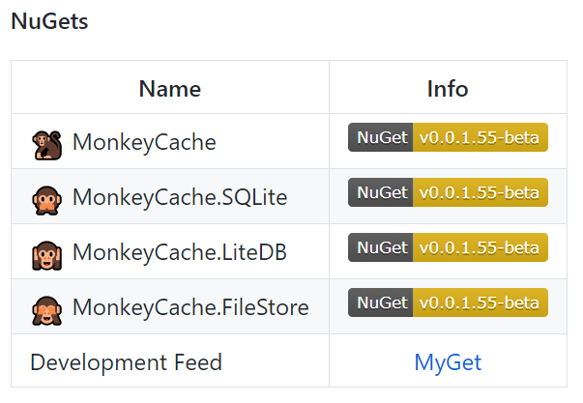
Monkey Cache
Monkey Cache consists of one core NuGet package with three backing store providers.

Slide 11
Monkey Cache
Sample Project Download Link
https://bit.ly/2WP7Kdp

Slide 12
Monkey Cache
// Setup Barrel.ApplicationId = “your_unique_name_here”; // Save Data Barrel.Current.Add(key, data, expireIn); // Retrieve Data Barrel.Current.Get<T>(key); // Remove Data Barrel.Current.EmptyAll();

Slide 13
Demo
Let’s do the caching!
https://bit.ly/2WP7Kdp

Slide 14
Thank you!
Shoot your Questions!
Cedric Gabrang, Senior Mobile Applications Developer @ XAM Consulting

